Slide 1
Course : COMP8043041 – Machine Learning
Period : June 2023
Data Exploration and Pre-processing
Session 02
KDS – Amalia Zahra, S.Kom., Ph.D.

Slide 2
Learning Outcomes
After the completion of this session, students are expected to achieve the following learning outcomes:
LO1: Able to explain the fundamental concept of Machine Learning and its various techniques/algorithms.
LO2: Describe the characteristics of various Machine Learning algorithms and understand how each of them works, including the mathematical principles underlying the algorithms.

Slide 3
Topics
Data Types
Data Quality
Data Pre-processing
Dimensionality Reduction
Principal Component Analysis (PCA)
Linear Discriminant Analysis (LDA)
Data Visualization

Slide 4
What is Data?
Attributes
Data: collection of data objects and their attributes.
An attribute is a property or characteristic of an object.
Examples: eye color of a person, temperature, etc.
Attribute is also known as variable, field, characteristic, or feature
A collection of attributes describe an object.
Object is also known as record, point, case, sample, entity, or instance
Objects

Slide 5
Data Types

Slide 6
Types of Attributes
There are different types of attributes CATEGORICAL
Nominal
Examples: ID numbers, eye color, zip codes
Ordinal
Examples: rankings (e.g., taste of potato chips on a scale from 1-10), height in {tall, medium, short}, professional rank {assistant, associate, professor}
NUMERIC
Numeric: Interval
Examples: calendar dates
Numeric: Ratio
Examples: monetary quantities, counts, age, mass, length, electrical current

Slide 7
Properties of Attribute Values
The type of an attribute depends on which of the following properties it possesses:
Distinctness: = ≠
Order: < >
Addition: + -
Multiplication: * /
Nominal attribute: distinctness
Ordinal attribute: distinctness & order
Interval attribute: distinctness, order & addition
Ratio attribute: all 4 properties

Slide 8
Discrete and Continuous Attributes
Discrete Attribute
Has only a finite or countably infinite set of values
Examples: zip codes, counts, or the set of words in a collection of documents
Often represented as integer variables.
Note: binary attributes are a special case of discrete attributes
Continuous Attribute
Has real numbers as attribute values
Examples: temperature, height, or weight.
Practically, real values can only be measured and represented using a finite number of digits.
Continuous attributes are typically represented as floating-point variables.

Slide 9
Types of Datasets
Record
Data Matrix
Document Data
Transaction Data
Graph
World Wide Web
Molecular Structures
Ordered
Spatial Data
Temporal Data
Sequential Data
Genetic Sequence Data

Slide 10
Record Data
Data that consists of a collection of records, each of which consists of a fixed set of attributes

Slide 11
Data Matrix
If data objects have the same fixed set of numeric attributes, then the data objects can be thought of as points in a multi-dimensional space, where each dimension represents a distinct attribute.
Such data set can be represented by an m by n matrix, where there are m rows, one for each object, and n columns, one for each attribute
Notes:
Notes: all attributes type are same type

Slide 12
Document Data
Each document becomes a `term' vector,
each term is a component (attribute) of the vector,
the value of each component is the number of times the corresponding term occurs in the document.

Slide 13
Transaction Data
A special type of record data, where
each record (transaction) involves a set of items.
For example, consider a grocery store. The set of products purchased by a customer during one shopping trip constitutes to a transaction, while the individual products that were purchased are the items.

Slide 14
Graph Data
Examples: Generic graph and HTML Links

Slide 15
Chemical Data
Benzene Molecule: C₆H₆

Slide 16
Ordered Data
Genomic sequence data

Slide 17
Spatio-Temporal Data
Spatio-Temporal Data
Average Monthly Temperature of land and ocean

Slide 18
Data Quality

Slide 19
Data Quality
What kinds of data quality problems?
How can we detect problems with the data?
What can we do about these problems?
Examples of data quality problems:
Noise and outliers
Missing values
Duplicate data

Slide 20
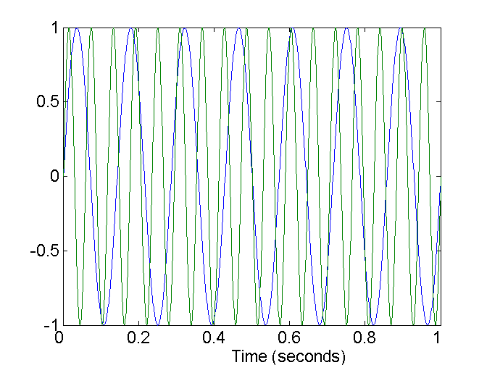
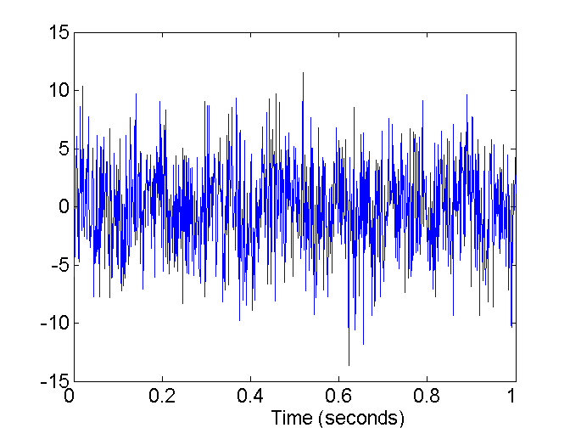
Noise
Noise refers to modification of original values
Examples: distortion of a person’s voice when talking on a poor phone and “snow” on television screen
Two Sine Waves
Two Sine Waves + Noise

Slide 21
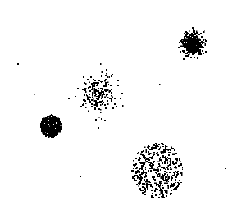
Outliers
Outliers are data objects with characteristics that are considerably different than most of the other data objects in the dataset.

Slide 22
Missing Values
Reasons for missing values
Information is not collected (e.g., people decline to give their age and weight)
Attributes may not be applicable to all cases (e.g., annual income is not applicable to children)
Handling missing values
Eliminate data objects
Estimate missing values
Ignore the missing value during analysis
Replace with all possible values (weighted by their probabilities)

Slide 23
Duplicate Data
Data set may include data objects that are duplicates, or almost duplicates of one another
Major issue when merging data from heterogenous sources
Examples:
Same person with multiple email addresses
Data cleaning
Process of dealing with duplicate data issues

Slide 24
Data Pre-Processing
“Data scientists spend 80% of their time cleaning and manipulating data and only 20% of their time actually analyzing it.”

Slide 25
Tasks in Data Pre-Processing
Data cleaning
Data integration
Data transformation
Data reduction
Data discretization

Slide 26

filling missing values
smooth noisy data
identify or remove outliers
resolve inconsistencies
Notes:
Source of image: https://www.digitalvidya.com/blog/data-cleaning-techniques/

Slide 27

Data Integration
Integration of multiple databases, data cubes, files, and unstructured data
Notes:
Source of image: https://www.dotgroup.co.uk/services/data-integration-health-check/

Slide 28

Data Transformation
Normalization
Aggregation
Generalization
Smoothing
Attribute Construction
Notes:
Source of image: https://www.g-able.com/products/data-management-platform/attachment/data-transformation/

Slide 29
Normalization
min-max normalization: to [new_min_{A}, new_max_{A}]
Ex. Let income range $12,000 to $98,000 normalized to [0.0, 1.0]. Then $73,600 is mapped to:

Slide 30
Normalization (cont.)
z-score normalization
μ: mean, σ: standard deviation
Ex. Let μ = 54,000, σ = 16,000. Then:

Slide 31
Normalization (cont.)
Normalization by decimal scaling
Where j is the smallest integer such that Max(|ν’|) < 1

Slide 32

Data Reduction
Reduce representation in volume, but produces the same or similar analytical results
Notes:
Source of image: https://www.cohesity.com/blogs/the-four-immutable-laws-of-data-reduction/

Slide 33

Data Discretization
Part of data reduction, but with particular importance, especially for numerical data
Notes:
Source of image: https://towardsdatascience.com/an-introduction-to-discretization-in-data-science-55ef8c9775a2

Slide 34
Dimensionality Reduction

Slide 35
Curse of Dimensionality
The collection of issues that arise when dealing with high dimensional data.
More data is good.
More detailed data (dimensions) might not be.

Slide 36
Why Reduce Dimensions?
Computation
Less dimensions allow us to compute models more efficiently.
Visualization
Difficult to visualize more than 3 dimensions
Remove useless information

Slide 37
Dimensionality Reduction
Dimensionality Reduction aims to map the data from the original dimension space to a lower dimension space while minimizing (relevant) information loss.

Slide 38
Types of Dimensionality Reduction
Feature Selection
Select features from the available features.
Ex: filter, wrapper, embedded
Feature Extraction
Generate synthetic (made up) features that represent the available features.
Ex: Principal Component Analysis (PCA), Linear Discriminant Analysis (LDA)

Slide 39
Principal Component Analysis (PCA)

Slide 40
Principal Component Analysis (PCA)
PCA is a technique used to emphasize variation and bring out strong patterns in a dataset.
It's often used to make data easy to explore and visualize.
Decomposes a dataset into a set of successive orthogonal components that explain a maximum amount of variance.
Demo: https://setosa.io/ev/principal-component-analysis/

Slide 41
PCA (cont.)
Given N data vectors from n-dimensions, find k ≤ n orthogonal vectors (principal components) that can be best used to represent data
Steps
Normalize input data: Each attribute falls within the same range
Compute k orthonormal (unit) vectors, i.e., principal components
Each input data (vector) is a linear combination of the k principal component vectors
The principal components are sorted in order of decreasing “significance” or strength
Since the components are sorted, the size of the data can be reduced by eliminating the weak components, i.e., those with low variance. (i.e., using the strongest principal components, it is possible to reconstruct a good approximation of the original data
Works for numeric data only
Used when the number of dimensions is large

Slide 42
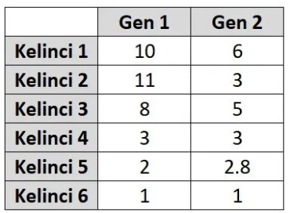
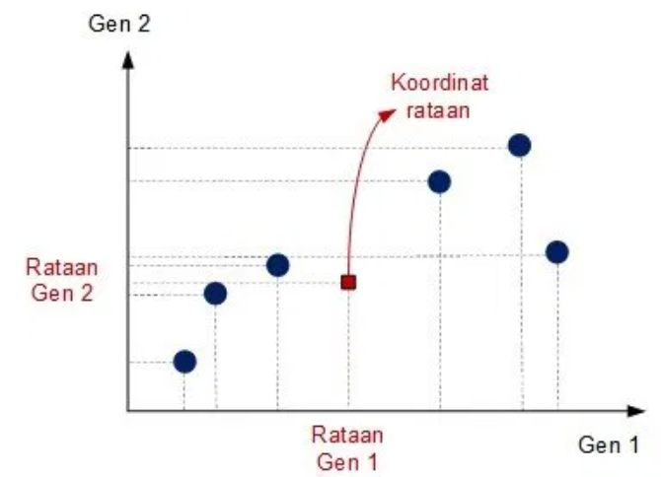
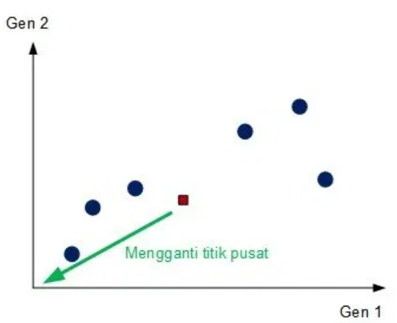
PCA (Example)
1
2
Notes:
Materi ini menggunakan contoh: https://www.megabagus.id/apa-itu-principal-component-analysis-pca/

Slide 43
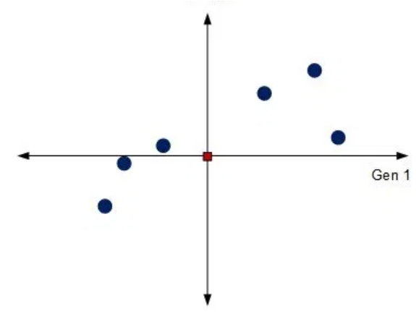
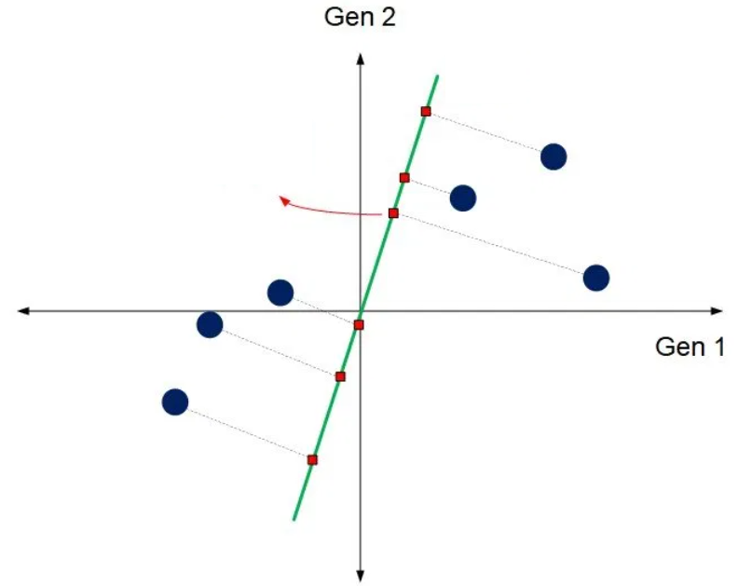
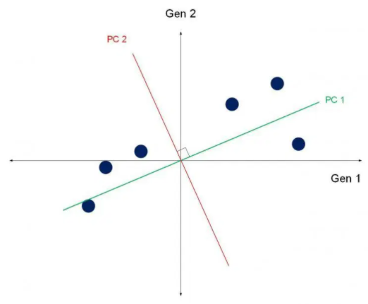
PCA (Example) – cont.
3
PC 1
candidate
(orthogonally) projected point
4
Goal:
Minimum orthogonal distance from each point to Principal Component (PC)
Maximum variance (maximum Sum of Squares)
Compute Variance from PC1
Compute Variance from PC2
to determine which features are important
Notes:
Materi ini menggunakan contoh: https://www.megabagus.id/apa-itu-principal-component-analysis-pca/

Slide 44
Linear Discriminant Analysis (LDA)

Slide 45
Linear Discriminant Analysis (LDA)
A supervised dimensionality reduction technique to be used with continuous independent variables and a categorical dependent variable.
How much can we reduce the number of features? Number of classes – 1

Slide 46
General Steps of LDA
Calculate the separability between different classes (i.e. distance between the means of different classes)
between-class variance or between-class matrix
Calculate the distance between the mean and the samples of each class
within-class variance or within-class matrix
Construct the lower dimensional space which maximizes the between-class variance and minimizes the within-class variance

Slide 47

Detailed Steps of LDA
Means
Scatter Matrices
Finding Linear Discriminants
Subspace
Project the data

Slide 48
Exercise
Find a paper highlighting the use of PCA or LDA in their research and investigate the model performance after applying PCA or LDA!

Slide 49
Data Visualization

Slide 50

Boxplot Analysis
Five-number summary of a distribution:
Minimum, Q1, M, Q3, Maximum
Boxplot
Data is represented with a box
The ends of the box are at the first and third quartiles, i.e., the height of the box is IRQ
The median is marked by a line within the box
Whiskers: two lines outside the box extend to Minimum and Maximum
Outliers
Max
Q3
M
Standard deviation
Mean
Q1
Min

Slide 51
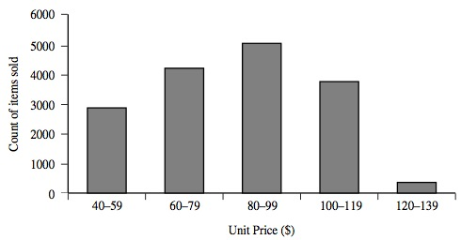
Histogram Analysis
Graph displays of basic statistical class descriptions
Frequency histograms
A univariate graphical method
Consists of a set of rectangles that reflect the counts or frequencies of the classes present in the given data

Slide 52
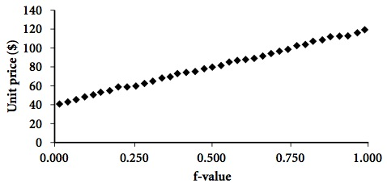
Quantile Plot
Displays all of the data (allowing the user to assess both the overall behavior and unusual occurrences)
Plots quantile information
For a data x_{i} data sorted in increasing order, f_{i} indicates that approximately 100 f_{i}% of the data are below or equal to the value x_{i}
Notes:
Data: 12, 8, 20, 4, 9, 13, 15, 7
Total= 88
Sorted data: 4, 7, 8, 9, 12, 13, 15, 20
Fi (%) = 4.6, 12.5, 21.5, … dst

Slide 53
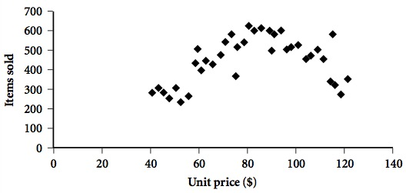
Scatter plot
Provides a first look at bivariate data to see clusters of points, outliers, etc.
Each pair of values is treated as a pair of coordinates and plotted as points in the plane.

Slide 54
Positively and Negatively Correlated Data
-
+
?
Notes:
Demo: correlation between a3 and a4 attributes of Iris data

Slide 55
Summary
Raw data are dirty usually due to incomplete, noisy and inconsistent.
Data Preprocessing is important to ensure the quality mining results.
Data cleaning is one of the three biggest problems in data warehousing.
Data integration combines data from multiple sources into a coherent store.
Data reduction reduces representation of the data set that is much smaller in volume but yet produce the same (or almost the same) analytical results.
Data visualization to make better understanding about data.

Slide 56
Exercise
Normalize the following data using:
min-max normalization, to fall between 0 to 1.
z-score normalization
Advertisement Cost (in $1,000) | 39 | 65 | 62 | 90 | 82 | 75 | 25 | 98 | 36 | 78
Sales (in $1,000) | 47 | 53 | 58 | 86 | 62 | 68 | 60 | 91 | 51 | 84

Slide 57
References
Bishop, C. M. (2006). Pattern recognition and machine learning. springer.
Harrington, P. (2012). Machine learning in action. Manning Publications Co.
Han, J., Kamber, M., & Pei, Y. (2006). “Data Mining: Concepts and Technique”. Edisi 3. Morgan Kaufman. San Francisco
Tan, P.N., Steinbach, M., & Kumar, V. (2006). “Introduction to Data Mining”. Addison-Wesley. Michigan
Witten, I. H., & Frank, E. (2005). “Data Mining : Practical Machine Learning Tools and Techniques”. Second edition. Morgan Kaufmann. San Francisco

Slide 58
Q&A

Slide 59
Thank You

